Slide 1
Teaching staff of the Foreign languages Chair
The authors of Control Educational Checking Work №1

Slide 2
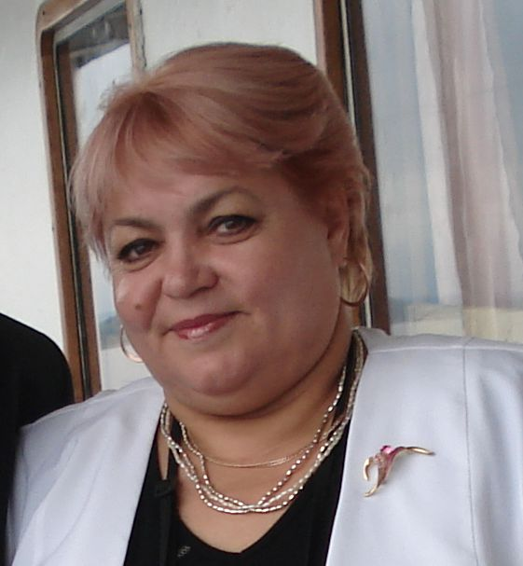
Khusnutdinova Faina Abdrahmanovna
Candidate of philosophical sciences, docent of the Foreign languages Chair of BSPU

Slide 3
Bojyko Marina Aleksandrovna
Teacher of the Foreign Languages Chair of BSPU

Slide 4
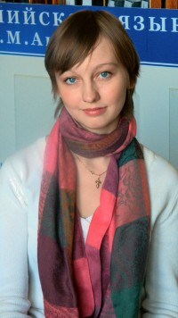
Antipova Tatiana Vjacheslavovna
Master of philological sciences, assistant teacher of the Foreign languages Chair of BSPU

Slide 5
The main textbook

Slide 6
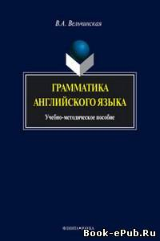
Additional materials

Slide 7
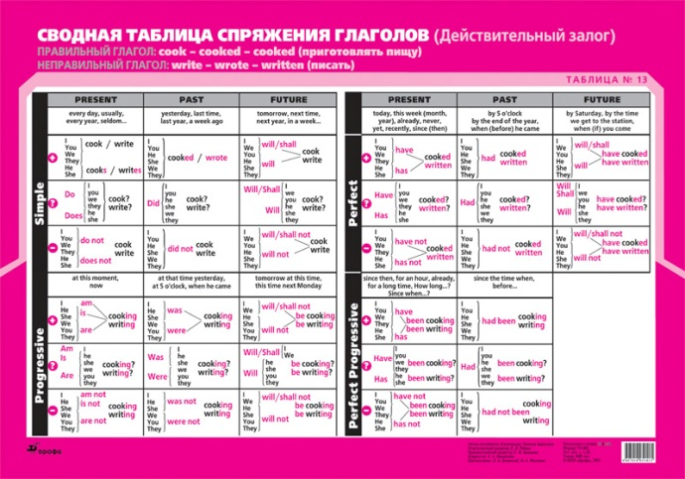
Tables

